Slide 1
Analysis of count data

Slide 2
Our typical RNA quantification pipeline
Upload your
sequence data (fastq)
Make report of quality metrics
Output ribosomal contamination metrics report
Align to the ribosome (Bowtie)
Produce RNA-Seq report
% aligned, % intergenic, % exonic, % UTR
Align remaining reads to genome (TopHat) or transcriptome (RSEM)
Produce IGV/UCSC friendly files
Quantify transcriptome
Produce a table with normalized expression values
Call differentially expressed genes
(if multiple samples)
Report pairwise significant genes that are differentially expressed

Slide 3
Were we left….
E(# f_{g}) = #reads *θg * l_{g}
f_{g} = Fragment from gene (transcript) g
θ_{g} = Fraction of gene g in sample
l_{g} = (effective) length of gene g

Slide 4
Revisiting correlation

Slide 5
Revisiting correlation
Notes:
Remember … Kendal Tau =[ (# concordant pairs) – (# non concordant)]/n(n-1)/2
Recall: Use R for the example.

Slide 6
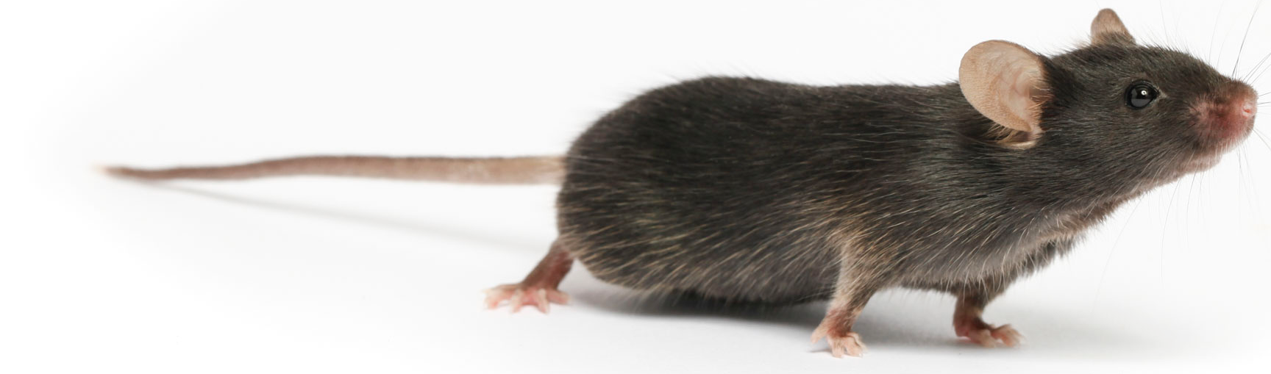
Experimental approach
L^{Δ1} = Jnk1 KO
L^{Δ2} = Jnk2 KO
L^{Δ1,2} = Double KO
L^{WT} = Wildtype
Genotypes
HF
CW
HF
CW
HF
CW
HF
CW
Diets
Rep1
Rep2
Rep3
Rep1
Rep2
Rep3
Rep1
Rep2
Rep3
Rep1
Rep2
Rep3
Rep1
Rep2
Rep3
Rep1
Rep2
Rep3
Rep1
Rep2
Rep3
Rep1
Rep2
Rep3
24 samples: 4 Genotypes x 2 Diets x 3 replicates

Slide 8
The gene expression table
Genes are quantified. Each gene or isoform has:
A TPM value
A (expected) fragment count vaue
All samples were quantified in the same fashion and arranged into a table of genes (22,000) x samples (24).
Row i gives the expression of the gene i across all samples
Row j gives the expression of genes in sample j.
gene | L^{Δ1,2}.rep1 | L^{Δ1,2}.rep2 | L^{Δ1,2}.rep3 | L^{Δ1.}rep1 | L^{Δ1}.rep2 | L^{Δ1}.rep3 | L^{Δ2}.rep1 | L^{Δ2}.rep2 | L^{Δ2}.rep3
Mir301 | 0 | 0 | 0 | 0 | 0 | 0 | 0 | 0 | 0
Cpne2 | 157 | 158.98 | 88.04 | 69 | 111.99 | 114.33 | 93 | 208 | 140
Capn5 | 36 | 65 | 46 | 46 | 69 | 42 | 33 | 58 | 59.01
Lage3 | 313.06 | 241.23 | 276.23 | 218.9 | 285.19 | 359.65 | 269.7 | 359.04 | 417.47
Brd7 | 379 | 358.58 | 390 | 336 | 357.26 | 368.08 | 264 | 564.07 | 476
Dimt1 | 77 | 68 | 58 | 54 | 62 | 60 | 54 | 76 | 97.03
AK017068 | 0 | 0 | 0 | 0 | 0 | 0 | 0 | 0 | 0

Slide 9
Q1: Who is expressed?

Slide 10
Q1: Who is expressed?

Slide 11
Q1: Who is expressed?
~10,000 genes

Slide 12
Q2: How do we model gene expression?
Normal distribution with mean and variance estimated from gene exp. data
Gene expression distributes roughly log-normal

Slide 13
Task1: How variable is my data?

Slide 14
Task 2: What may be my power?
vs
High Fat diet
High Fat vs Normal diet

Slide 15
Task 3: How can I look at ALL my data at once?
Matrices are too large, takes too much compute power:
Initial 25,000 x 24 = 500,000 entries
Filtering reduces by half: 250,000 entries
We can focus on interesting genes. Which ones?
Genes that vary most are most informative, how do we find them?
Variance or standard deviation
Coefficient of variance: sd/mean!

Slide 16
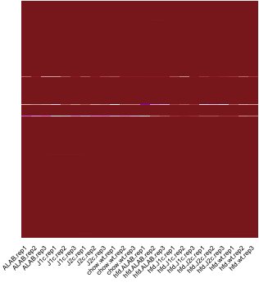
Task 3: How can I look at ALL my data at once?
Sort by CV plot top variable genes

Slide 17
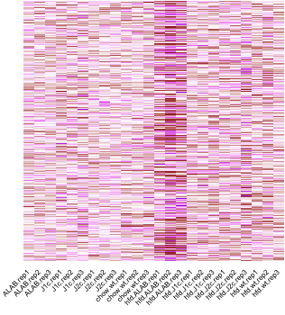
Task 3: How can I look at ALL my data at once?
Sort by CV plot top variable genes, but also “scale” values

Slide 18
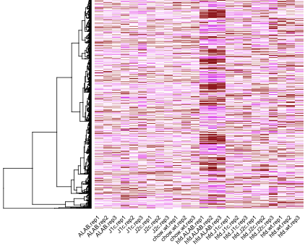
Task 3: How can I look at ALL my data at once?
Sort by CV plot top variable genes, but also “scale” and “cluster” values

Slide 19
Task 3: How can I look at ALL my data at once?
Sort by CV plot top variable genes, but also “log-scale” and “k-cluster” values
Normal diet
High Fat diet

Slide 20
What is clustering?

Slide 21
Clustering – Similar patterns
Samples
Genes

Slide 22
Hierarchical clustering – when are vector similar?
Gene | Cond1 | Cond2 | Cond3 | Cond4
g₁ | 2.5 | 5 | 7.5 | 10
g₂ | 0.1 | 0.5 | 0.8 | 1.1
g₃ | 0.2 | 0.3 | 0.4 | 11
g₄ | 2.5 | 8 | 8 | 9
Clustering is about similarity:
Between two rows (specified by a distance function)
Between two sets of rows (specified by the linkage method)

Slide 23
What is a distance?
The goal of clustering is to group together samples that are “similar”.
When are two expression profiles “similar”?
We consider each expression profile as a large “vector”. Each gene being a “dimension”
Euclidean distance
Correlation distance

Slide 24
What do difference distance care for?
Similar correlation distance, very different euclidean distance
Correlation distance almost 0

Slide 25
Similarity between groups of points
Linkage: Distance between two sets (d(R,S))
Single Linkage
Complete Linkage
Average Linkage

Slide 26
Similarity between groups of points
Linkage: Distance between two sets (d(R,S))
Complete:
Average:
Single:
Distance: Correlation, geometric (euclidean)
Gene | Cond1 | Cond2 | Cond3 | Cond4
g₁ | 2.5 | 5 | 7.5 | 10
g₂ | 0. | 0.5 | 0.8 | 1.1
g₃ | 0.2 | 0.3 | 0.4 | 11
g₄ | 2.5 | 8 | 8 | 9

Slide 27
The effect of the linkage method
Gene | Cond1 | Cond2 | Cond3 | Cond4
g₁ | 2.5 | 5 | 7.5 | 10
g₂ | 0.1 | 0.5 | 0.8 | 1.1
g₃ | 0.2 | 0.3 | 0.4 | 11
g₄ | 2.5 | 8 | 8 | 9

Slide 28
The effect of the linkage method
Correlation distance matrix

Slide 29
Effect of the distance!
Column1 | g1 | g2 | g3 | g4
g1 | 0.00 | 12.25 | 8.88 | 3.20
g2 |  | 0.00 | 9.91 | 13.28
g3 |  |  | 0.00 | 11.24
g4 |  |  |  | 0.00
Correlation distance matrix
Geometric (Euclidean) distance matrix

Slide 30
Playing with clustering
#Define the toy matrix#
#######################
m = rbind (c(2.5,5,7.5,10), c(0.1,0.5,0.8,1.1), c(0.2,0.3,0.4,11), c(2.5,8,8,9))
#Give column and row names#
###########################
rownames(m) = c("g1","g2","g3","g4");
colnames(m) = c("c1","c2","c3","c4");
#Compute the correlation distance matrix#
#########################################
submat.dist = as.dist( (1 - cor(t(m)) ) /2 );
#Plot clustering with the three main methods#
#############################################
plot( hclust(submat.dist, method="complete",members=NULL), main="Complete linkeage - correlation", sub="", xlab="", lwd=3);
plot( hclust(submat.dist, method="average",members=NULL), main = "Average Linkeage - correlation", sub="", xlab="", lwd=3);
plot( hclust(submat.dist, method="single",members=NULL), main = "Single Linkeage- correlation", sub="", xlab="", lwd=3);
#Plot clustering with the three main methods, using the euclidean distance#
###########################################################################
plot( hclust(dist(m), method="complete",members=NULL), main="Complete linkeage - euclidean", sub="", xlab="", lwd=3);
plot( hclust(dist(m), method="average",members=NULL), main = "Average Linkeage - euclidean", sub="", xlab="", lwd=3);
plot( hclust(dist(m), method="single",members=NULL), main = "Single Linkeage - euclidean", sub="", xlab="", lwd=3);

Slide 31
Convinced of power – direct comparison
Compare groups of samples to tease out genes that are (even subtly) different between samples. Ideally we should:
Incorporate inter group variability
Changes in mean
Goal: Define a statistic that capture both group mean and variance.
Power: For a given gene, can use the statistic to reject the null hypothesis that the mean gene expression is the same for the two groups?
Two approaches:
Parametric:
Find a distribution that fits gene expression values
Fit the distribution for each gene
Statistic: likelihood ratio (different means vs same mean). The t-test is a special case when we assume values are Gaussian distributed.
Non parametric:
Define a statistic i.e. a t-test
Permute samples to estimate values under randomness

Slide 32
Task 4: Finding the genes that differ between conditions
Recall that intuitively gene expression follows a simple binomial model
In practice, the observed variance exceeds the mean, a sign that this is not the right model. A different distribution, the “negative binomial” explains better gene expression across replicates. The negative binomial is determined by its mean and variance.
Current methods estimate the mean for each gene across replicates then estimate variance for genes with similar expression mean to increase the estimate robustness.
Test: Likelihood ratio test fitting two different mean and variance for each group of replicates vs a model that uses the same mean and variance across all replicates.

Slide 33
Task 4: Finding the genes that differ between conditions
 | baseMean | log2FoldChange | lfcSE | stat | pvalue | padj
Gm10680 | 1706.444506 | 3.112741296 | 0.307812566 | 7.67590916 | 1.64249E-14 | 2.59131E-11
Gm15441 | 570.059034 | 2.51195109 | 0.305538932 | 5.766699111 | 8.08392E-09 | 2.55075E-06
BC044868 | 84.33739286 | 2.489946733 | 0.23813335 | 7.306606714 | 2.73973E-13 | 2.35766E-10
Gpnmb | 159.988699 | 2.448488099 | 0.31026759 | 5.474268509 | 4.39323E-08 | 1.22313E-05
Cgref1 | 91.22187245 | 2.386996101 | 0.304450438 | 5.376888639 | 7.5784E-08 | 2.04963E-05
Ppp1r3g | 59.45598745 | 2.353683977 | 0.322862231 | 4.967084475 | 6.7967E-07 | 0.000126152
Apoa4 | 27008.03585 | 2.177590962 | 0.303513773 | 4.703545893 | 2.55682E-06 | 0.000410217
Bcl2l14 | 27.57604462 | 2.090578545 | 0.322425406 | 4.157794392 | 3.21335E-05 | 0.002982115
Lamb3 | 384.2696995 | 2.033628639 | 0.175630137 | 7.308703732 | 2.69732E-13 | 2.35766E-10
D330041H03Rik | 32.45424455 | 1.96146267 | 0.30178968 | 4.014261424 | 5.96322E-05 | 0.005085393
Krt23 | 87.52892053 | 1.951166495 | 0.295386495 | 4.066423196 | 4.77402E-05 | 0.004145952
Igfbp2 | 13252.29789 | 1.928489158 | 0.238558789 | 4.940036634 | 7.81079E-07 | 0.000142186
Resulting in 528 genes at log2FoldChange > 0.75 and pvalue < 0.05

Slide 34
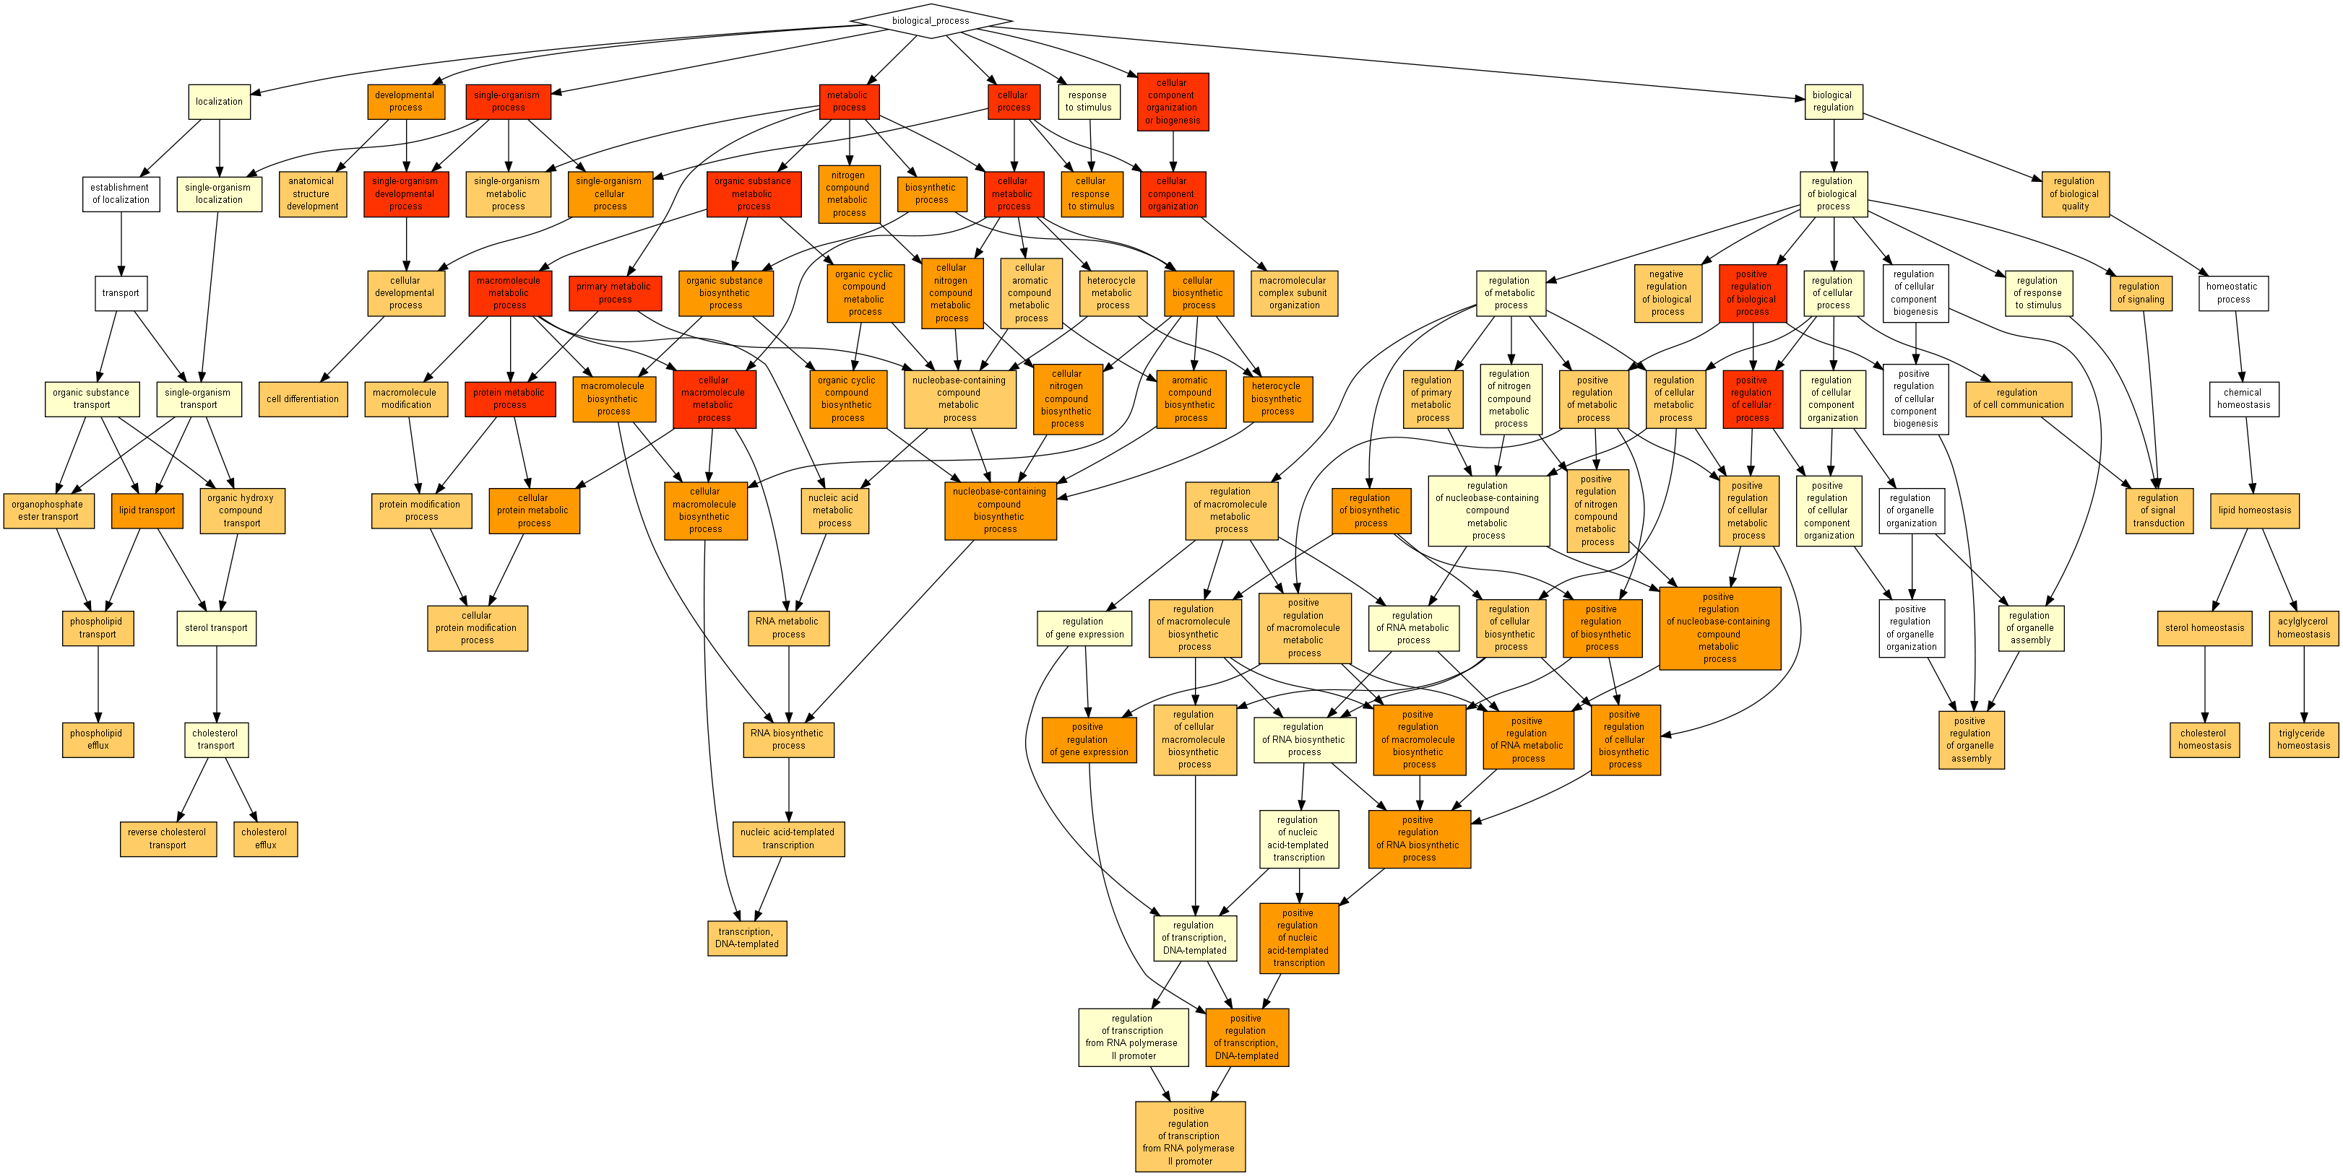
Task 6: What are these genes?
Protein
Process
Cholesterol
&
Triglyceride
Homeostasis
Lipid transport
& cholesterol
Transcription
Cholesterol homeostasis:
5.98 (15170, 56, 453, 10)
P < 5.31x10⁻⁶
Notes:
EXPLAIN THE HYPERGEOMETRIC HERE!

Slide 35
Why do we “adjust” the p-value?
 | baseMean | log2FoldChange | lfcSE | stat | pvalue | padj
Gm10680 | 1706.444506 | 3.112741296 | 0.307812566 | 7.67590916 | 1.64249E-14 | 2.59131E-11
Gm15441 | 570.059034 | 2.51195109 | 0.305538932 | 5.766699111 | 8.08392E-09 | 2.55075E-06
BC044868 | 84.33739286 | 2.489946733 | 0.23813335 | 7.306606714 | 2.73973E-13 | 2.35766E-10
Gpnmb | 159.988699 | 2.448488099 | 0.31026759 | 5.474268509 | 4.39323E-08 | 1.22313E-05
Cgref1 | 91.22187245 | 2.386996101 | 0.304450438 | 5.376888639 | 7.5784E-08 | 2.04963E-05
Ppp1r3g | 59.45598745 | 2.353683977 | 0.322862231 | 4.967084475 | 6.7967E-07 | 0.000126152
Apoa4 | 27008.03585 | 2.177590962 | 0.303513773 | 4.703545893 | 2.55682E-06 | 0.000410217
Bcl2l14 | 27.57604462 | 2.090578545 | 0.322425406 | 4.157794392 | 3.21335E-05 | 0.002982115
Lamb3 | 384.2696995 | 2.033628639 | 0.175630137 | 7.308703732 | 2.69732E-13 | 2.35766E-10
D330041H03Rik | 32.45424455 | 1.96146267 | 0.30178968 | 4.014261424 | 5.96322E-05 | 0.005085393
Krt23 | 87.52892053 | 1.951166495 | 0.295386495 | 4.066423196 | 4.77402E-05 | 0.004145952
Igfbp2 | 13252.29789 | 1.928489158 | 0.238558789 | 4.940036634 | 7.81079E-07 | 0.000142186

Slide 36
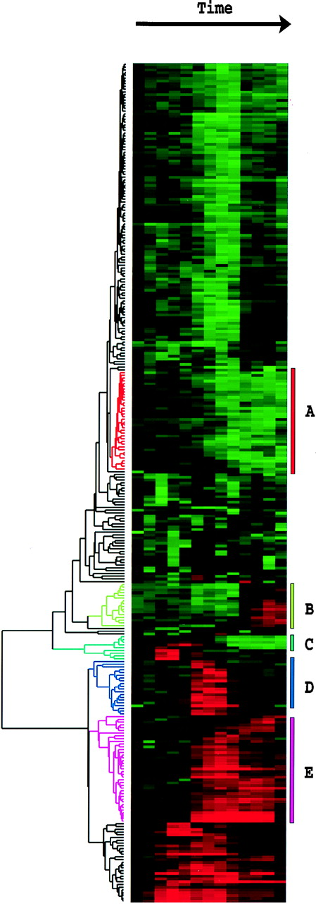
Where are we?
80s
90s
Islan et al Nat. Imm. 2011
Thousands of datapoints
Handful of datapoints
Michael B. Eisen et al. PNAS 1998

Slide 37
Biology slowly becoming a “big data” science
2010s
Sequenced reads
Millions-billions datapoints

Slide 38
Statistical methods are deeply embedded – two concepts
Multiple testing problems
Modeling count data

Slide 39
We can’t use a nominal p-value any longer
P < 0.05
All will be noise!

Slide 40
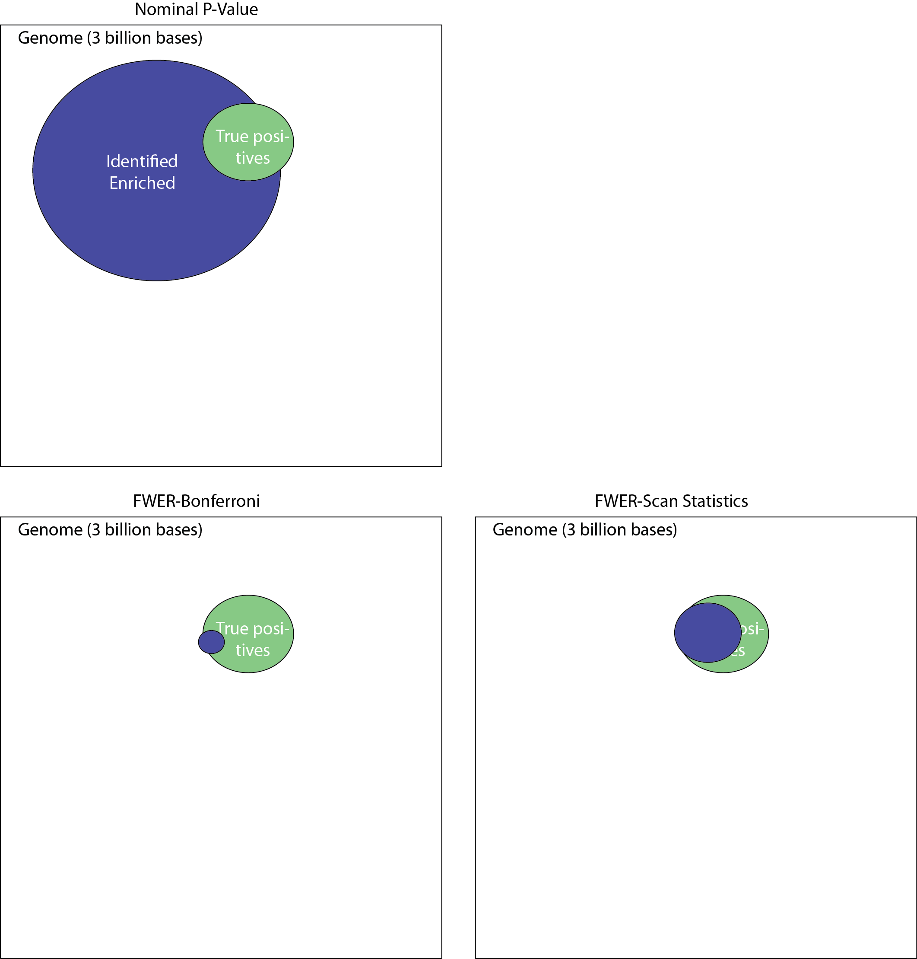
The genome is large, many things happen by chance
Expected ~150,000,000 bases
We need to correct for multiple hypothesis testing

Slide 41
The Bonferroni correction
Correction factor 3,000,000,000
Bonferroni corrects the number of hits but misses many true hits because its too conservative – How do we get more power?

Slide 42
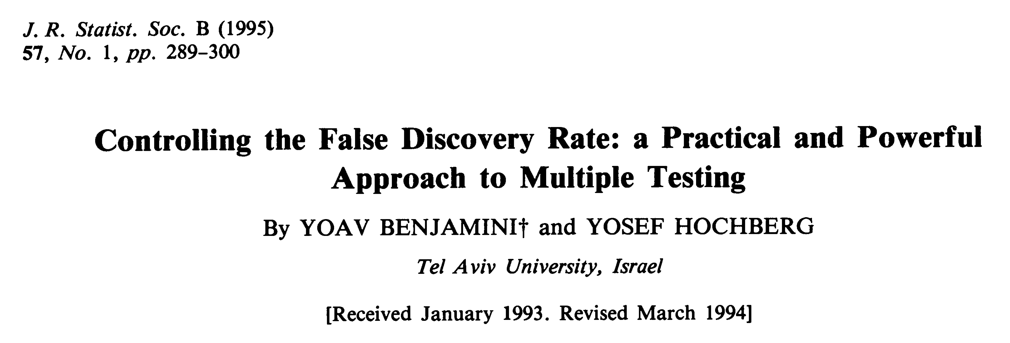
Can we correct for multiple testing a bit more subtly?
Downloadable from: http://garberlab.umassmed.edu/bootcamp.2015/BH.pdf

